Slide 1
Working conditions

Slide 2
Working Conditions in Resource Industries and Factory Work
The Industrial revolution was a time of big change in the way products were made and distributed.
In earlier days, people made product by hand.
During the Industrial Revolution, many factories were built.
There were now many people working in factories and making large amounts of products.
Many immigrants came to work in both factories and resource industries and came from Central, Eastern and Southern Europe, Ukraine, Poland, Italy, and Asia, especially China.
Many people also worked for resource industries including mining, fishing and logging and farming.

Slide 3
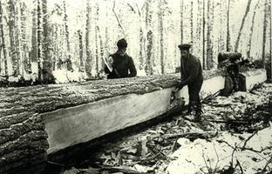
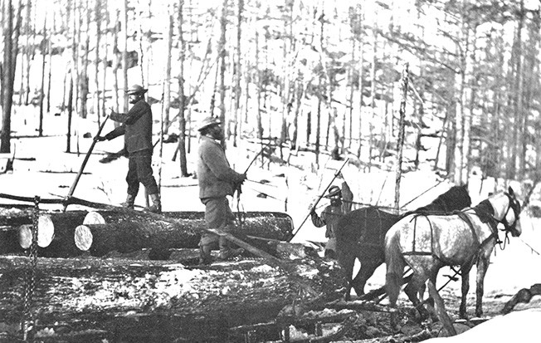
Resource Industry: Logging
Wood was a very important trade resource for much of the 19th Century in Canada. The wood was in high demand in Europe. The timber trade brought investment and immigration to eastern Canada.
In the fall, camps were built and roads were cleared for moving logs. They stayed in shanty houses that were often crowded. The center of the shanty house had a fire or wood stove in the middle with a opening in the roof to let the smoke out. The loggers slept in bunkbeds, often doubled up in each bed to keep warm. Their diet consisted of pork, beans, soup and bread and sometimes fish partridge or other wild meat.
Logging was a difficult and dangerous work with a small pay.
At work, trees were felled with a saw or an axe. Timber was squared by axemen. Logs were hauled by oxen and horses to rivers. The lumber was floated down the river to mills or to river-mouth booms.

Slide 4
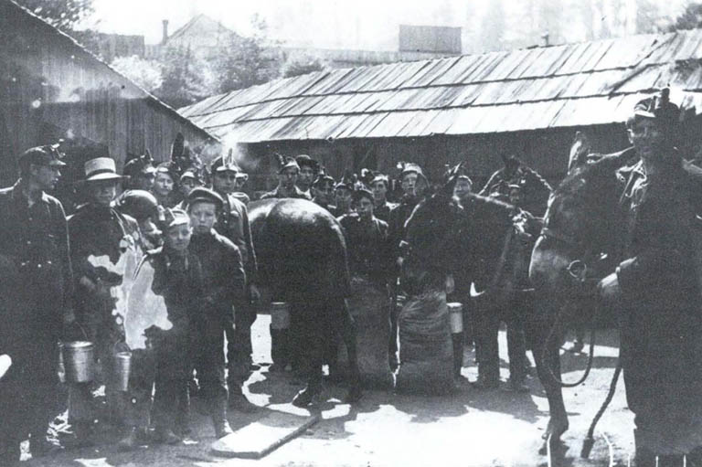
Resource Industry: Mining
In the early 1900s, coal was king. The industrial revolution was underway and it depended on coal to keep its engines humming.
Underground, Cape Breton coal miners like Matthius "Tius" Tutty worked in dangerous, primitive conditions.
"I had a lot of accidents. Theres no question about it ... I had this hand smashed ... I had that skull fracture(d)" remembered Tutty. "I got to make a living and there's no other place to go. I said, I'm not a coward. If I die down there well I'll die down there.
"Tutty starting working in the Glace Bay coal mines when he was 14 years old. His father had drowned and Tutty became the first in five generations to leave the sea.
Tutty drove horses that hauled boxes of coal along the underground tracks. He worked six days a week, surrounded by other child miners, some as young as nine.

Slide 5
Mining (cont.)
Here's how one of them remembers life in the mine:
"We had been ... working 12 hours a day loading in a low seam on our hands, being cursed at from morning to night by a greedy boss and seeing daylight only on Sundays ... We faced the prospects of a dismal and unhappy existence.”
The children ran the horses until they were old enough to swing a pick axe and handle blasting powder. After a few years, Tutty got a pickaxe and a job mining coals for the seams of mine. He was paid for each box of coal he delivered to the surface. But he had to pay for his own equipment, explosives and clothes.
Dominion Coal controlled almost every aspect of a miners life in Glace Bay. The company owned the stores and houses and determined the wages and working conditions. At the end of a month Tutty could take home as little as 70 cents.
But Tutty remained a miner. He had little education and no choice.

Slide 6
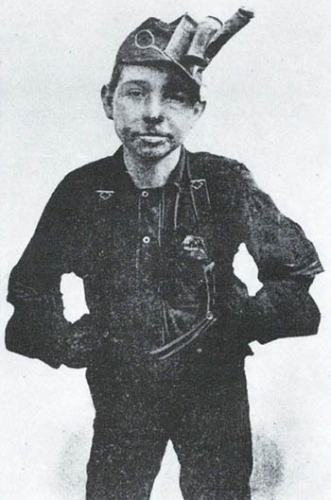
Resource Industry: Mining
In 1909, many Cape Breton miners including Tutty joined a strike organized by the newly formed United Mineworkers of America. The union wanted to challenge the dominance of the mine owners over the workers. It was a long and violent strike and 500 armed Canadian soldiers were sent to Cape Breton to deal with the potential unrest.
For ten months, Tutty lived nervously under the sights of the machine guns, with no pay or relief. Children died of cholera and starvation. Finally the miners went back to work. The strike had failed.
"Maybe I should have kept fishing," Tutty said. "I don't know how I'm living. I really don't.”
Tutty lived his entire life in Glace Bay and died there at the age of 95.

Slide 7
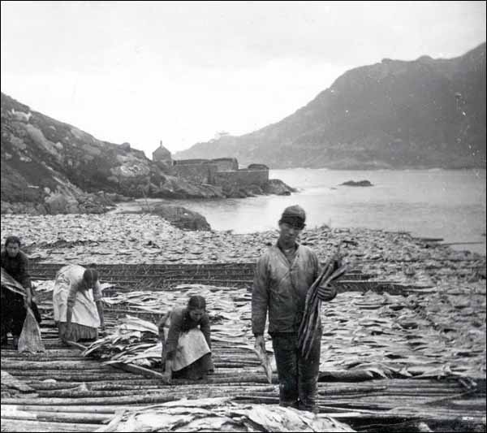
Resource Industry: Fishing
Marine creatures had sustained Aboriginal peoples in the Atlantic and Pacific coast for thousands of years. These resources later attracted European settlers.
Merchants sent out ships and and hired crews to fish for cod on the coasts of Newfoundland and Nova Scotia. Merchants also hired families to fish inshore with small boats. Men and boys caught fish as women and girls cured the fish on shore.
The fishermen and their families were supplied with fishing gear through credit from the merchants that they would have to pay back.
In the days before refrigeration, people salted the cod that went to markets in Europe, the Caribbean, and South America.

Slide 8
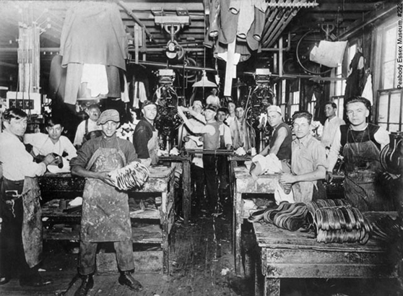
Factory Work
Men, women and children were found working in factories across Canada at the turn of the century.
Machines did most of the work in the factories, so people could work without training. Because of this, women and children were able to work more.
Factories used assembly lines to produce goods. A product was made by many workers who each did a small job. The worker would spend the entire day doing the same task.
Health problems sometimes occurred from doing the repeated task and the workers usually had no breaks and little time to eat.

Slide 9
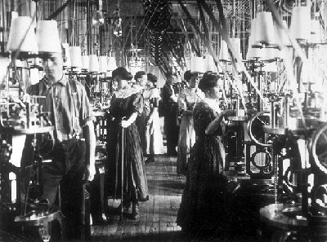
Factory Work (cont.)
The environment of most factories were unhealthy. Some factories were too cold or too hot. Poor lighting caused eye strain for some. Loud noise from machines sometimes damaged hearing or was deafening. Some experienced lung problems or lung disease because of small fibres in the air.
The machines were not always safe. It was easy for workers to catch a finger or on arm in equipment. People became tired from working for such long hours which made the chance of accidents higher.

Slide 10
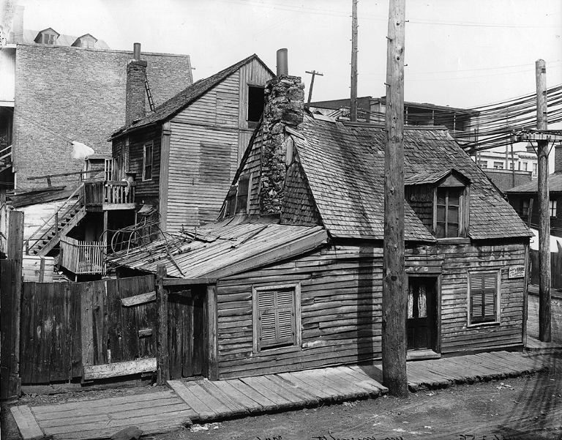
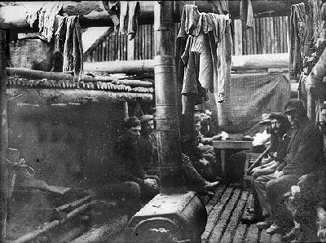
Factory Work
Many factory workers lived in “company towns” similar to the living situation that resource workers lived in.
More often, they lived in the poorest parts of the city
Sometimes, families were crowded into one or two rooms in a rooming house or in a wooden shelter.
There was no running water or sewage.
Wood stoves were used to keep warm and for cooking.
The crowdedness made disease common and spread quickly
Working class housing in Montreal, 1903
Factory worker camp

Slide 11
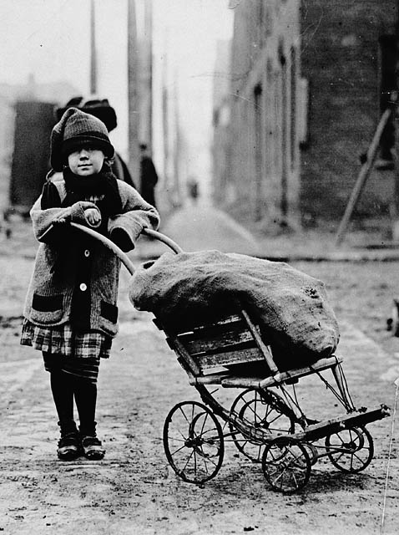
Child Labour
Prior to the 19th century, children were often helping make money for the family and seen as economic assets to the family. By 1911, 40% of children attended school.
Industrialization and urbanization created opportunities of paid employment for children who were not in school.
These jobs were often poorly paid jobs that didn’t require much skill and had no opportunity for advancement. Jobs like messenger boy and newspaper vendor did not lead to adult employment.

Slide 12
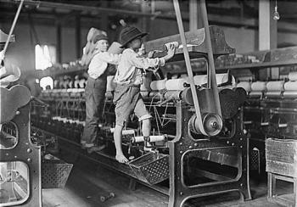
Child Labour (cont)
Hours were long with no breaks and children were punished for small mistakes or if they played or rested at work.
Factory equipment was dangerous and the hard work was damaging to the childrens health.
Many child laborers were immigrant children brought from Britain
Children were paid less than women, and women were paid less than men.

Slide 13
Women
Factory work gave women a different opportunity for work. Not many women were educated and the only work they could find was domestic work as servants for the wealthy or helpers on the farm.
When doing domestic work, they had little privacy and would have to move in with the family that hired them.
Factory work was difficult and low-paying, but this allowed them to have a job where they can meet others and have a day off once a week.
Women were the main factory workers in textile and garment (cloth and clothing) industries.

Slide 14
Women (Cont)
Another job now available for women was office work. They would learn typing, shorthand and other tasks in a 6 month business school. In the office they would also have to tidy up and make refreshments for their male bosses.
Women could also work at home as doing piecework. This was when they were paid a “piece” for completing something such as rolling cigars. Women did this for less pay than in factories and often worked for a male boss.

Slide 15
Conclusion
Working conditions for Industry resource workers and Factory workers were not the greatest. People got paid very little for the dangerous and/or difficult work they had to do. These workers were called the ”working class” and most of them lived in poverty.
Women were paid less than men despite the fact that they worked as hard. Children were paid less than women, even if they did the same work as well.

